Slide 1



MSHL Vehicle Rental System
KING ABDUL AZIZ UNIVERSITY COLLEGE OF COMPUTING AND INFORMATION TECHNOLOGY DEPARTMENT OF INFORMATION SYSTEM
An Online Vehicles Rental System

Slide 2
agenda
Purpose of the Project
Goals and Objectives
​Work Breakdown Structure (WBS)
​Staffing Procedure and Plan (HR Management)
Organizational chart and histogram (HR Management)
Major Project Milestones (Demonstrate using MS Project)
Detailed Project Schedule (MS Project)

Slide 3
Purpose of the Project:
In our project management project, we will create a project management plan for an online vehicle rental system. MSHL vehicle rental system is a web-based application which purpose is to allow users to lease small vehicles such as bicycles, scooters, and motorcycles in an easy and fast way that saves the customer's time.

Slide 4
Goals
Enables faster booking for customers
Offers a simpler approach to look for transportation options
Benefits users greatly, it is more convenient than paying for the ownership and maintenance.
Lends vehicles for a price for a few hours, a few days, or a week or more.
Enables Customers to choose the desired brand, size, and color.
Enables Customers to reserve their vehicles from anywhere in the county.
Saves customers’ time by avoiding the need to call and wait for a car.

Slide 5
Objectives
Allow users a quick access to all the system's services and schedule appointments according to their preferences.
Automate management to enable staff members to control the rental system more effectively.
It must offer clients protection, privacy, and assistance
It must provide a simple and user-friendly interface for clients
Take into consideration any issues that may arise during development to ensure that the system is error-free.
Create a database that stores all clients' information to eliminate data redundancy.

Slide 6
The Scope
The online vehicles rental system allows clients to book an appointment to lease a bicycle, a scooter, or a motorcycle through an online platform.
MSHL vehicle rental system will enhance the customer's experience by allowing the user to browse a list of vehicles, select one, schedule a leasing appointment, number of leasing days and payment options.
The project will also deliver a new database to hold customers’ information, along with a database server to house the data.
The project requires the project team to create a software system and a user-friendly interface where clients can write and read reviews about the services system, the project also requires the project team to make sure that all stakeholder requirements are met.

Slide 7
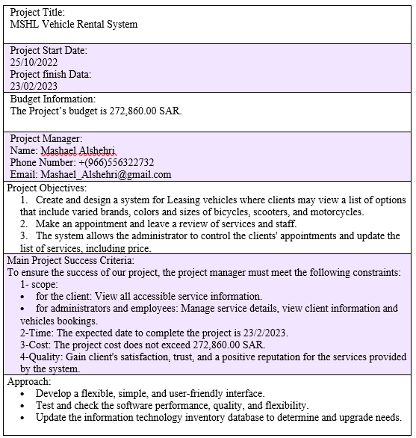
charter

Slide 8
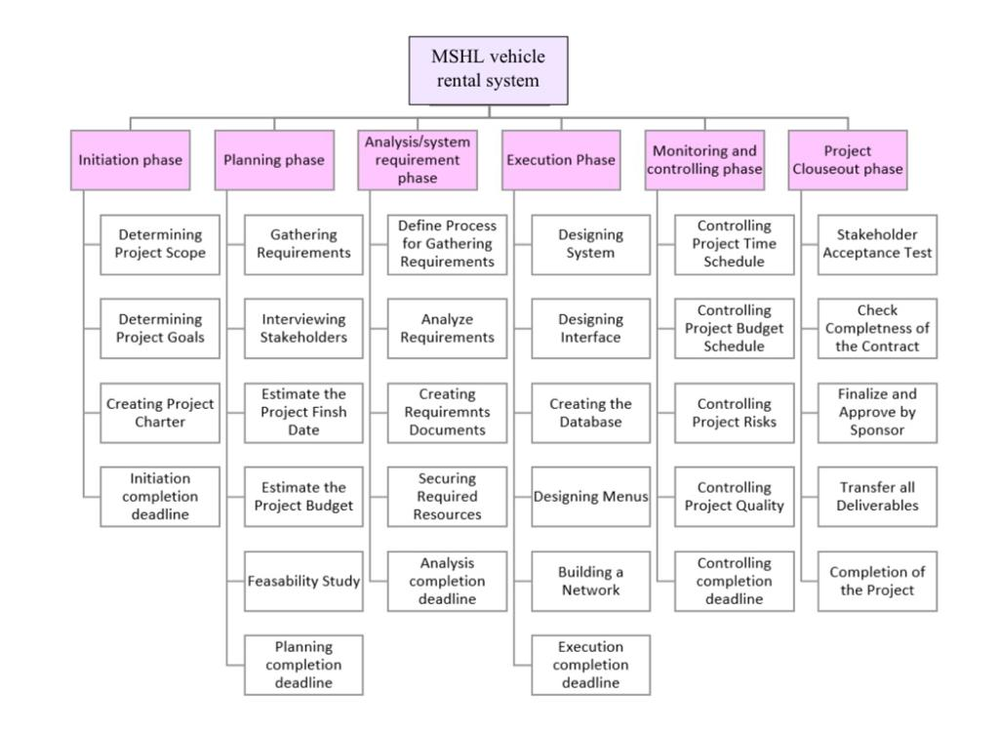
work Breakdown Structure (WBS)

Slide 9
Staffing Procedure and Plan (HR Management)
1
Determining acceptance criteria for each job.
2
Designing an appropriate advertisement that includes the vacancies with the required skills and contact information.
3
Publishing advertisement on social media and perfect advertising sites.
4
Receiving the applicants for the jobs.
5
Sorting the applicants and choosing the optimum and the best for the job/s based on the job's acceptance criteria.
6
Making interviews for the candidates.
7
Taking the approvals of the candidates to work and sign the contract of work with them.
8
Introducing employees to the working environment.
8
Providing a training for employees.

Slide 10
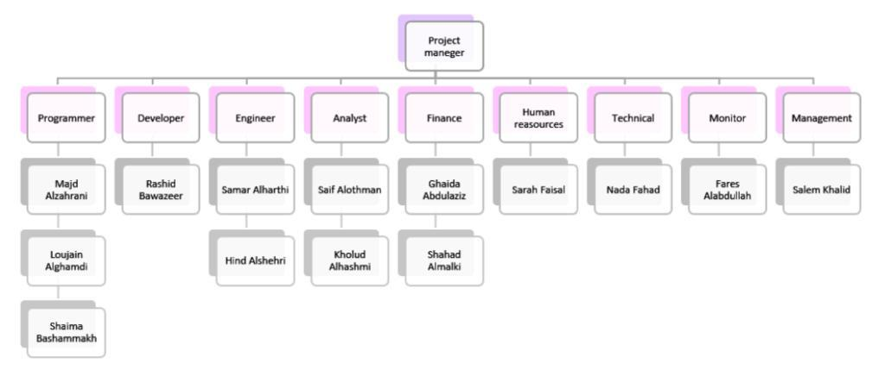
Organizational chart and histogram (HR Management)

Slide 11
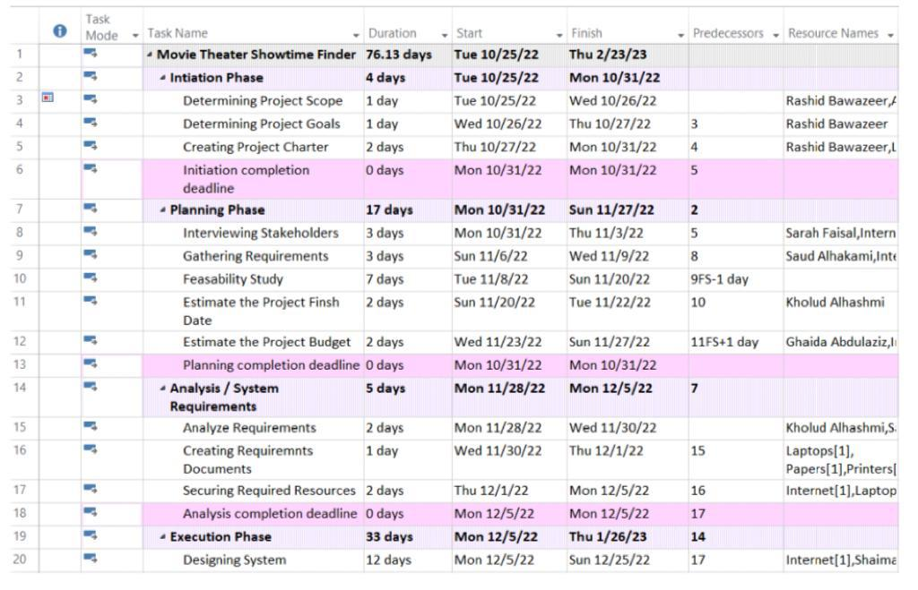
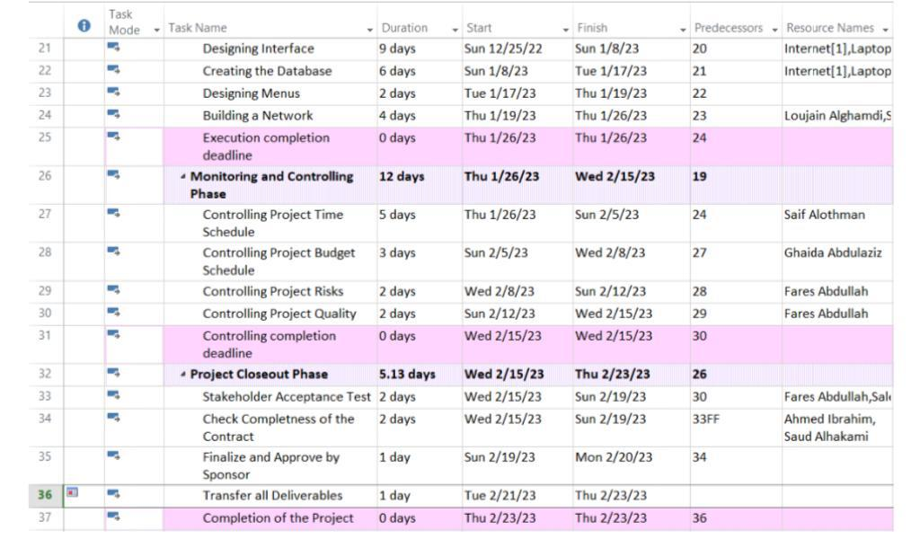
Major Project Milestones (Demonstrate using MS Project)

Slide 12
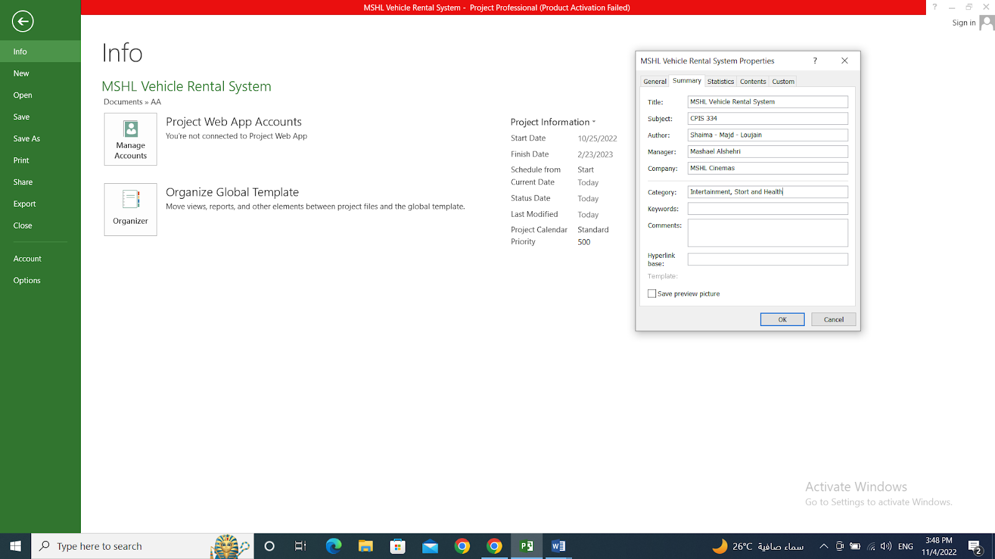
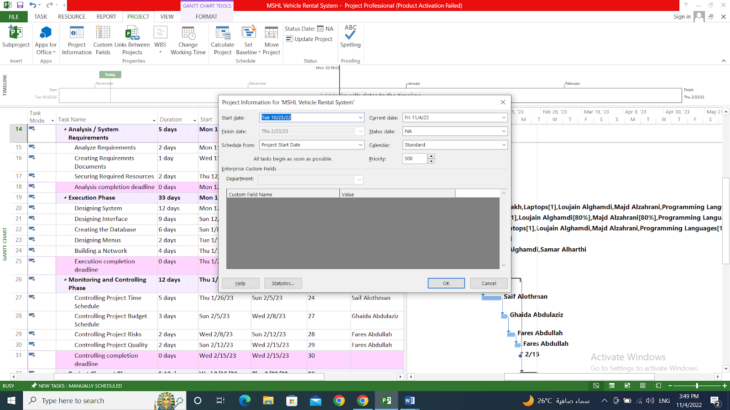
Detailed Project Schedule (MS Project)
Screenshot of Each Step
Enter general project information, such as the project name and start date

Slide 13
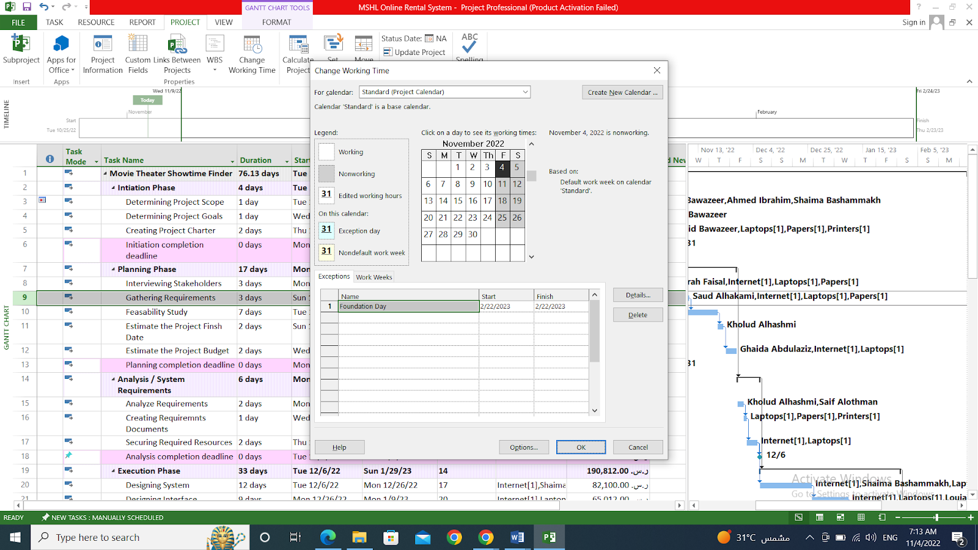
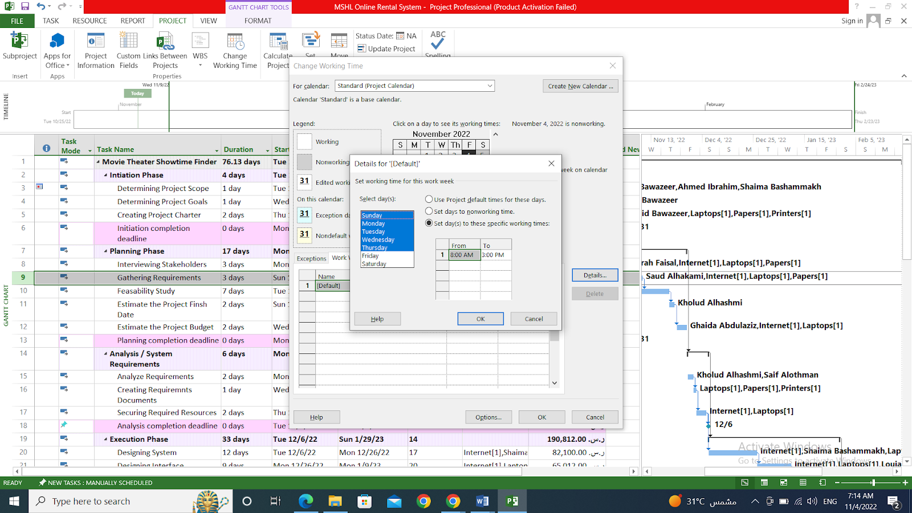
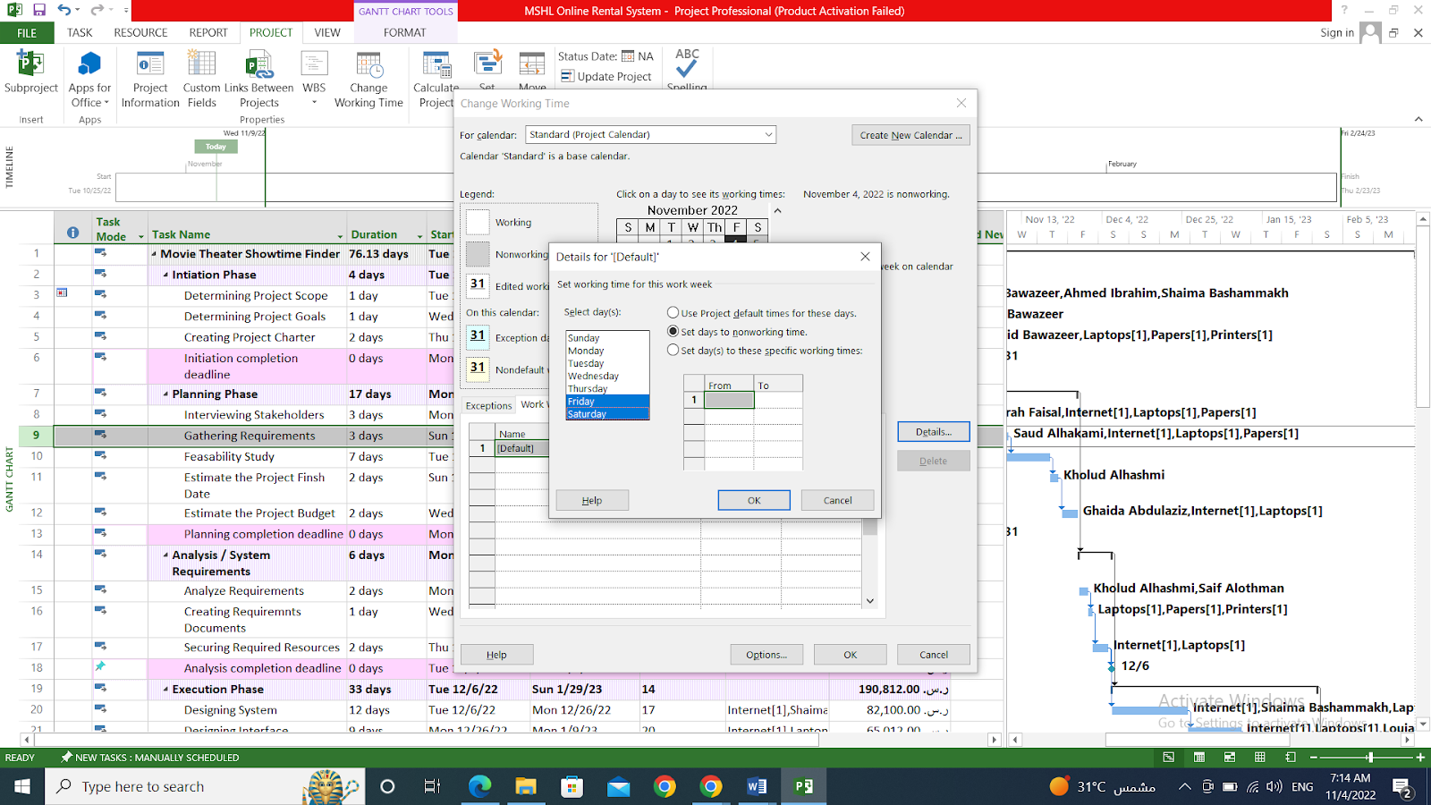

Slide 14
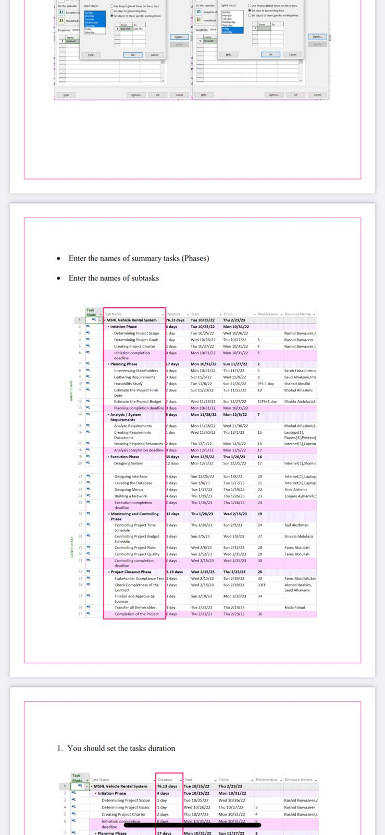

Slide 15
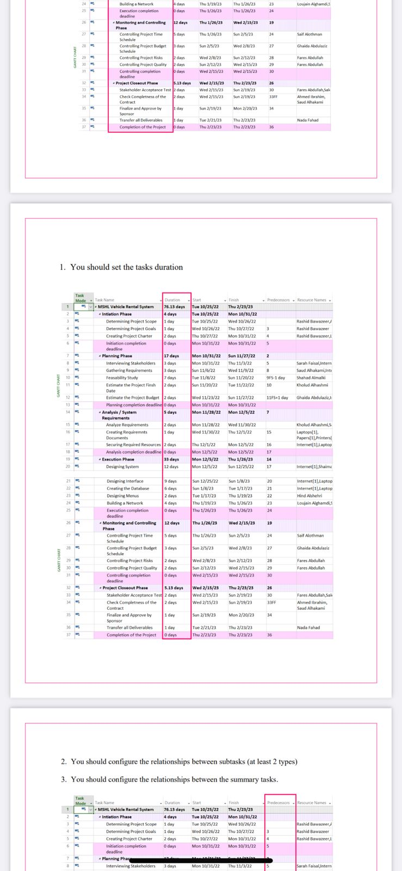

Slide 16
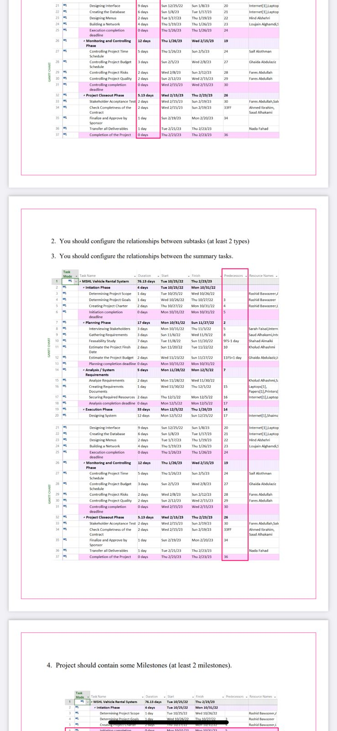

Slide 17
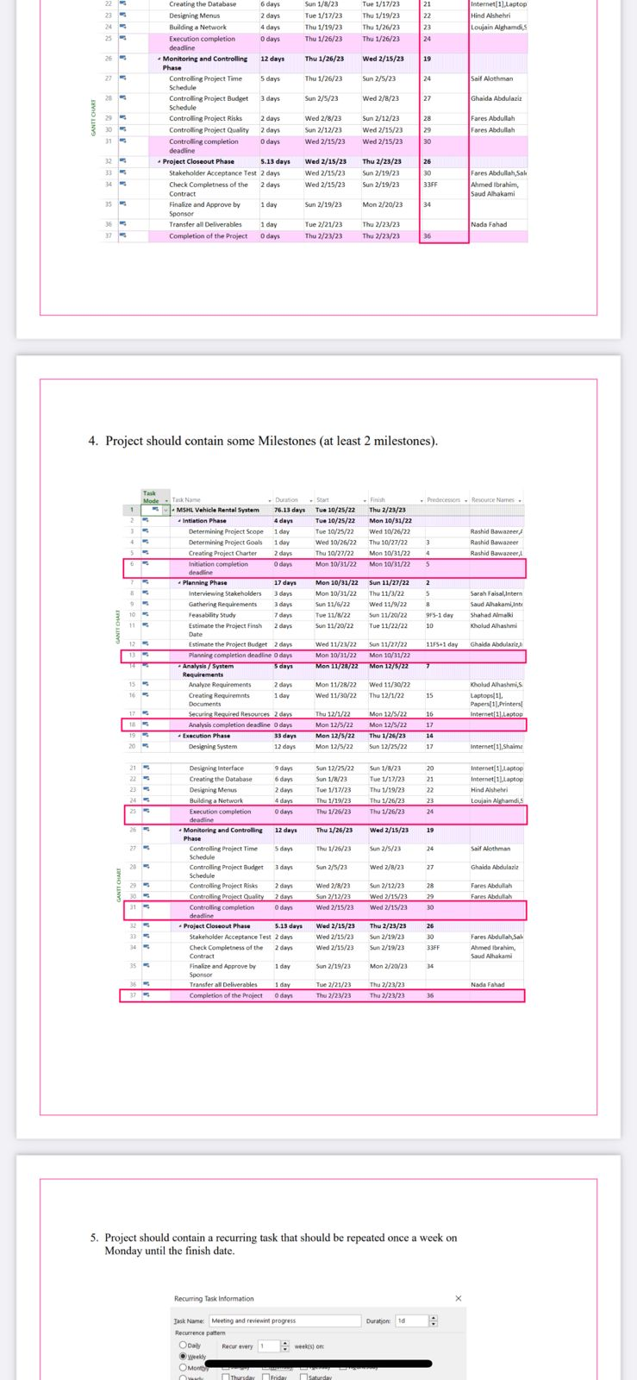

Slide 18
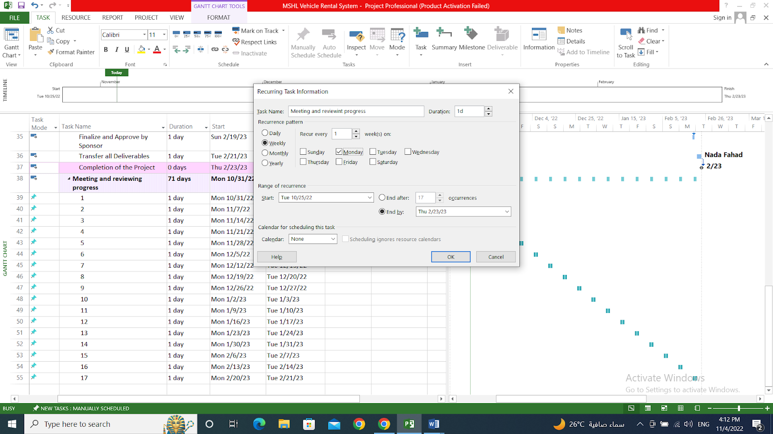
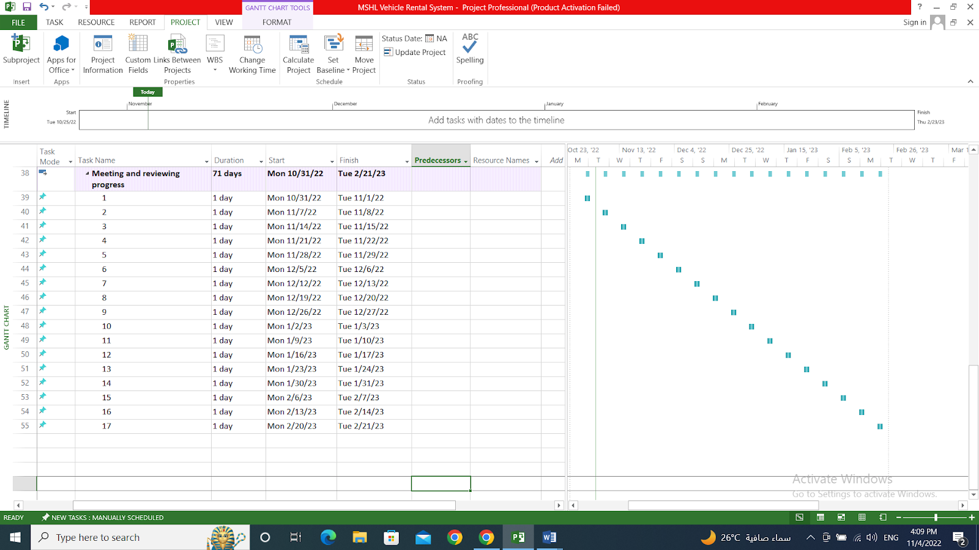

Slide 19
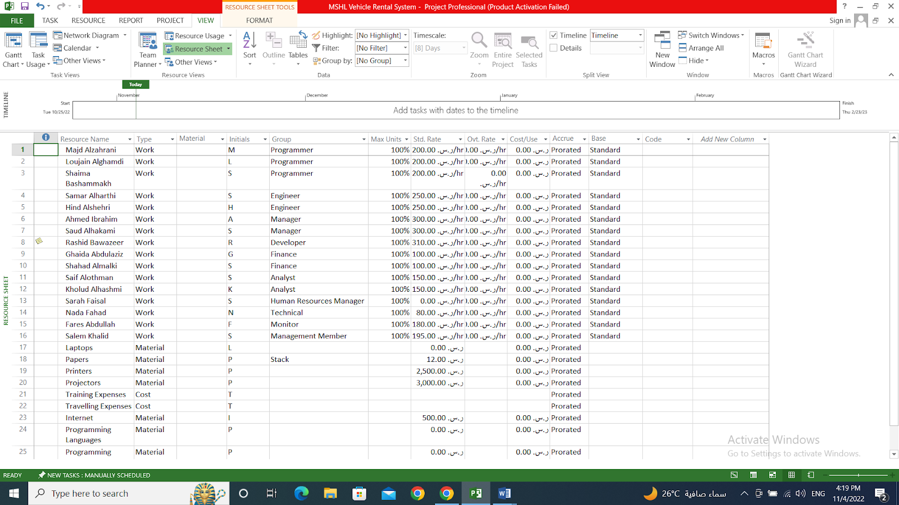
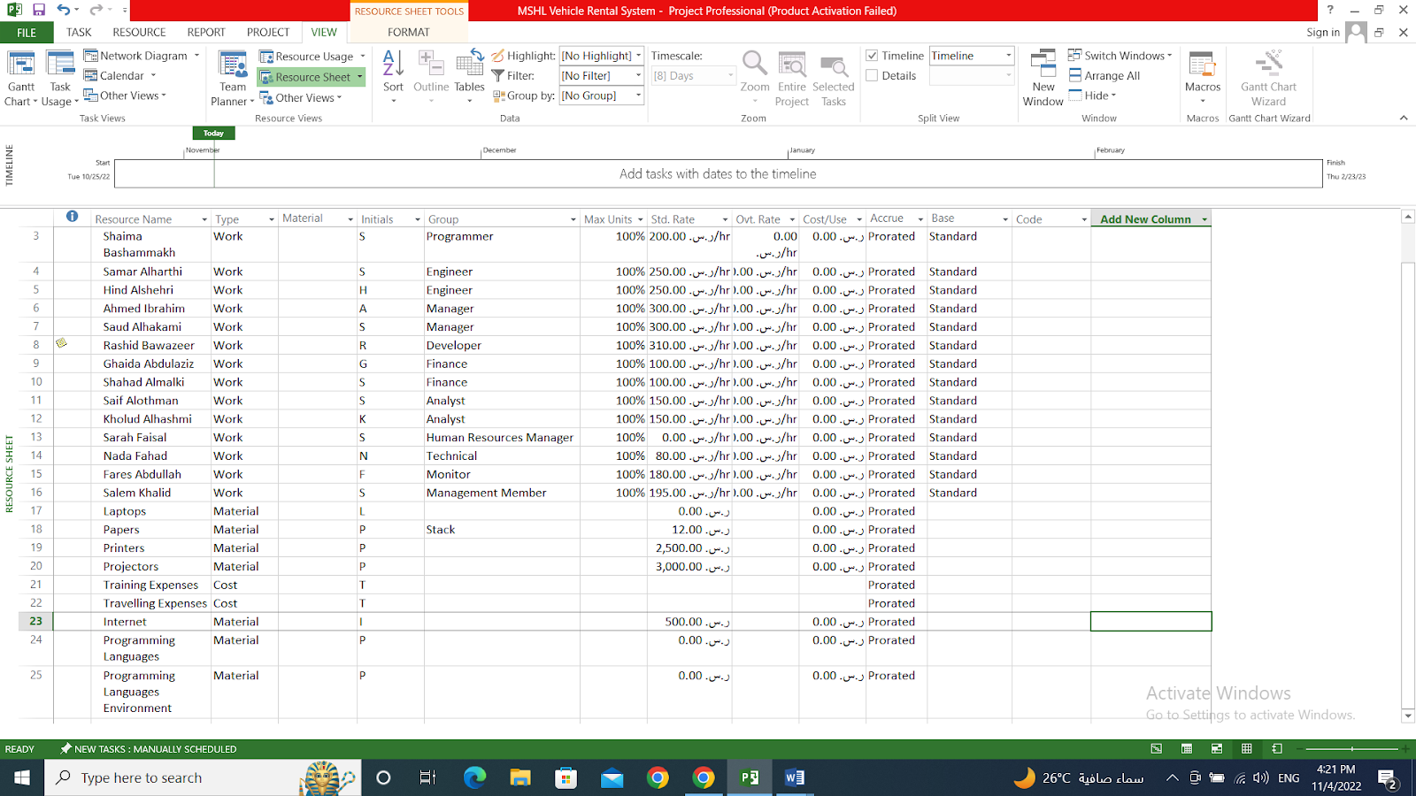

Slide 20
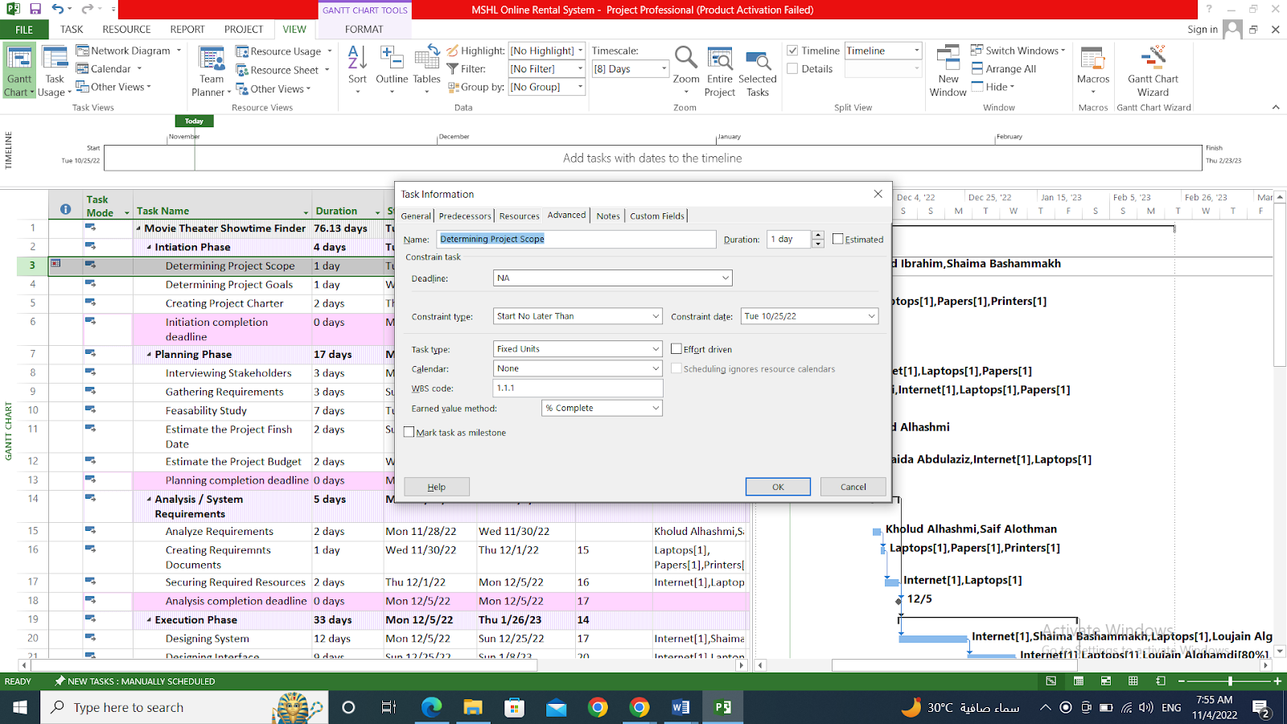
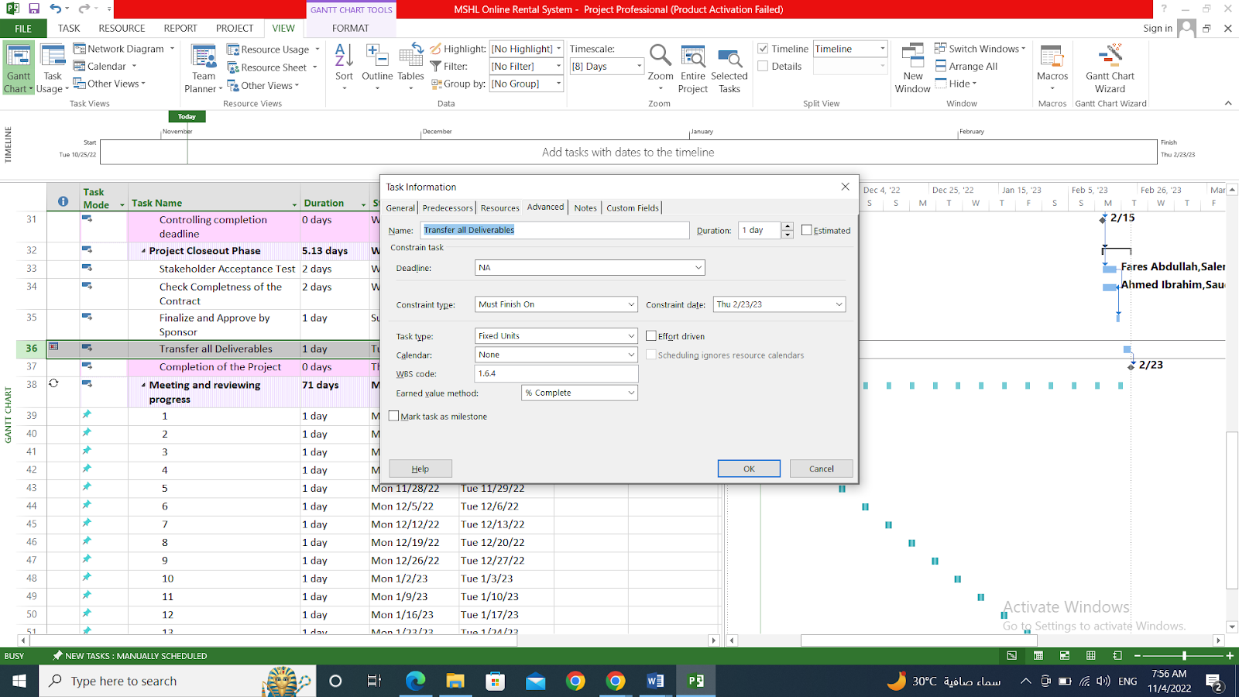

Slide 21
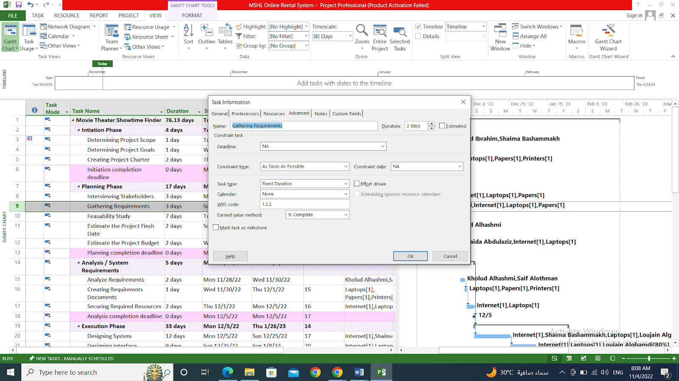
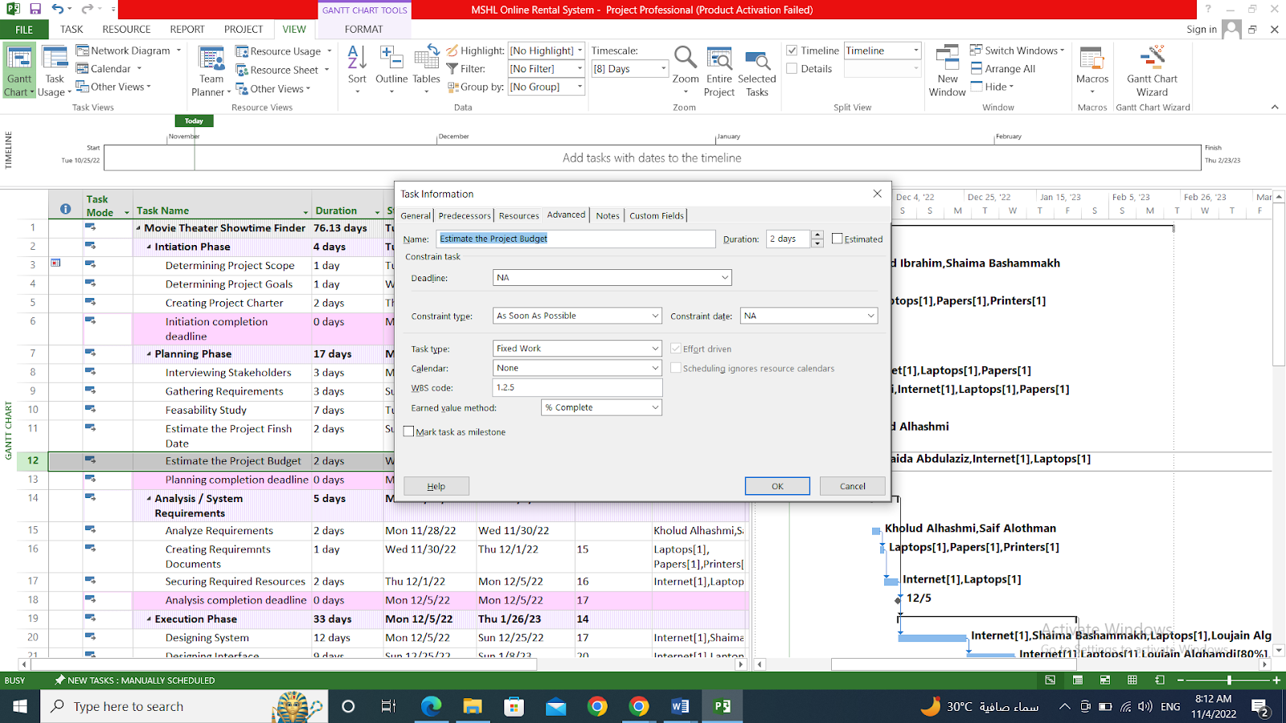

Slide 22
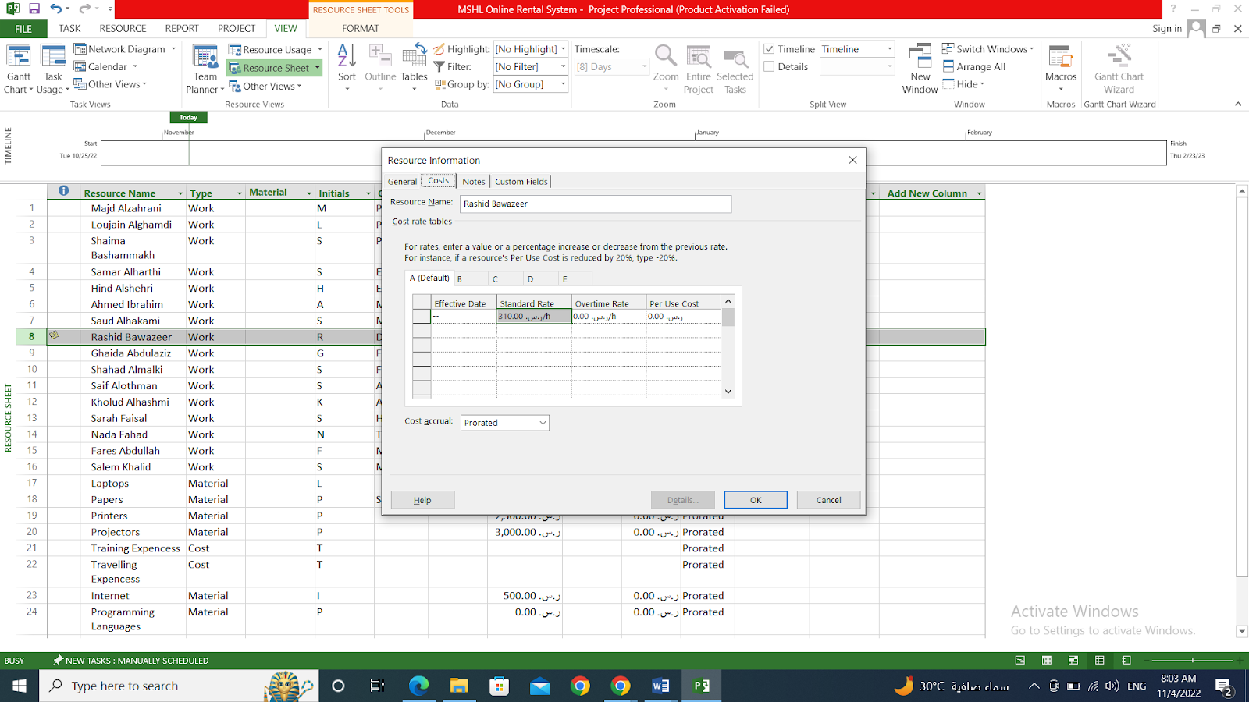

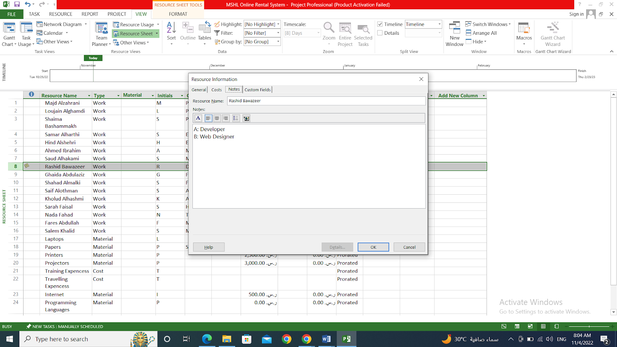

Slide 23
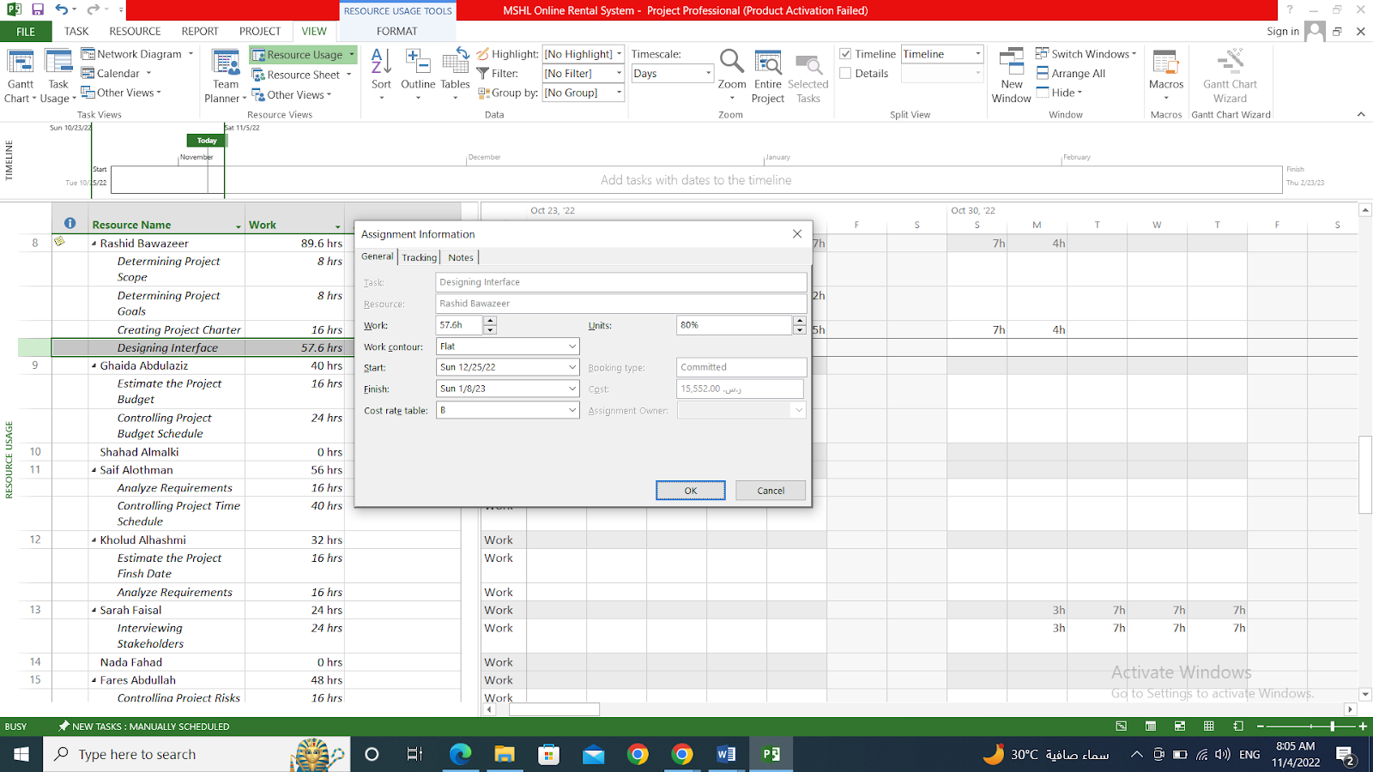

Slide 24
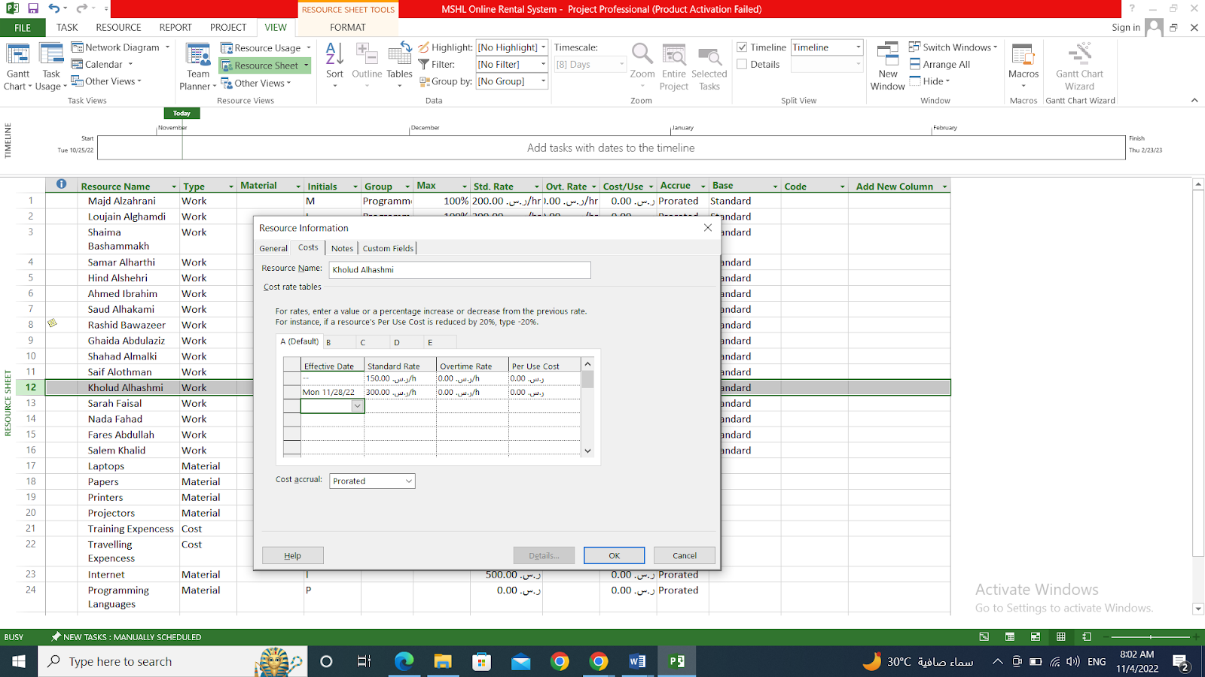

Slide 25
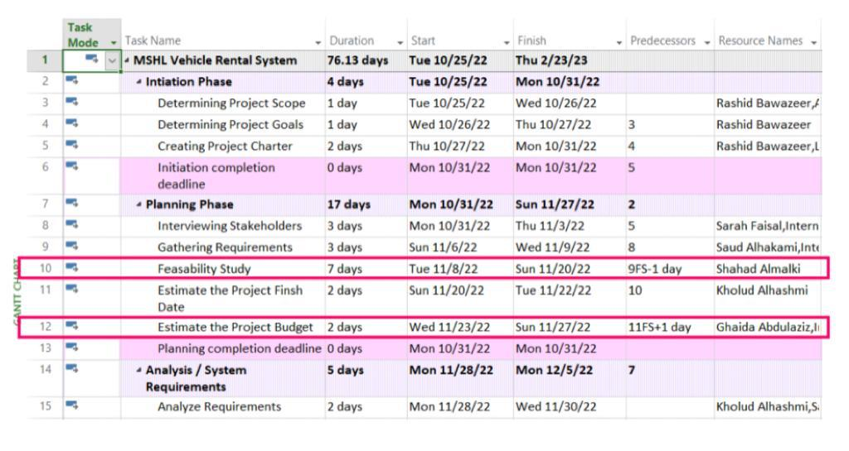

Slide 26
Team Members
Shaima Abdullah Bashammakh - 1914892
Loujain Mohammed Alghamdi – 1808114
Majd Saleh Alzahrani - 1816903

Slide 27
Thank you for your listening

